Slide 1

DATA ANALYSIS USING POWER BI
STORE SALES ANALYSIS

Slide 2
DATA CLEANING
Used Excel power query to clean and transform the data.
Apply necessary steps such removing duplicate, Splitting columns and changing data type.

Slide 3
TOOLS
Power BI
Excel

Slide 4
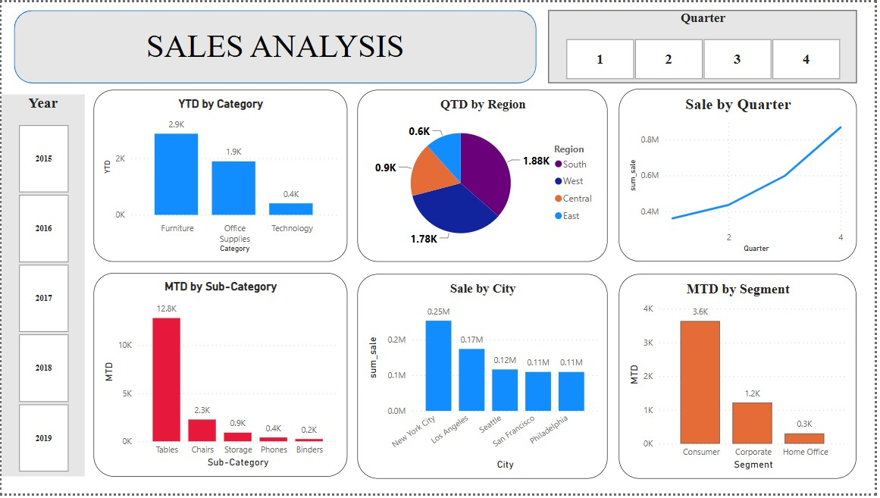
VISUALIZATION

Slide 5
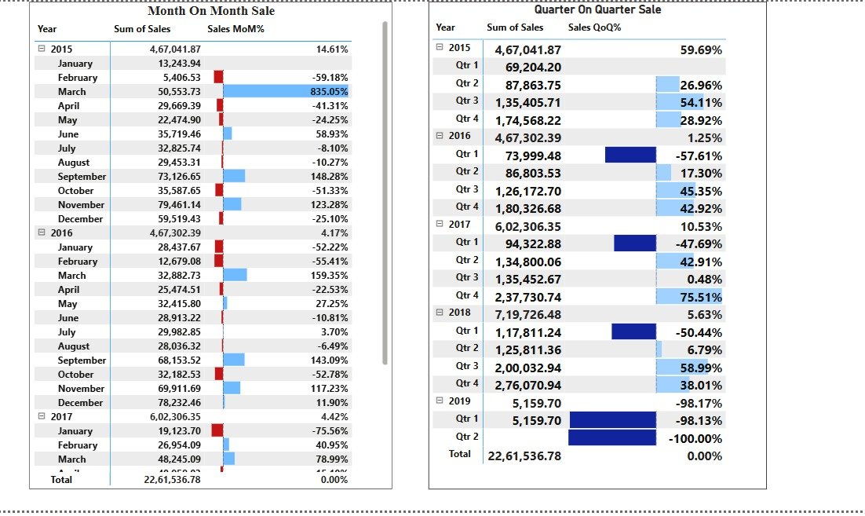

Slide 6
INSIGHTS
𝐘𝐓𝐃 𝐛𝐲 𝐂𝐚𝐭𝐞𝐠𝐨𝐫𝐲:Furniture is the highest revenue-generating category with 2.9K in sales
𝐐𝐓𝐃 𝐛𝐲 𝐑𝐞𝐠𝐢𝐨𝐧:The South Region (1.88K) is the highest contributor
𝐒𝐚𝐥𝐞 𝐛𝐲 𝐐𝐮𝐚𝐫𝐭𝐞𝐫:Sales have shown a steady increase across the quarters.
𝐌𝐓𝐃 𝐛𝐲 𝐒𝐮𝐛-𝐂𝐚𝐭𝐞𝐠𝐨𝐫𝐲:Tables (12.8K) dominate sales, tables are a key revenue driver while Phones and Binders are in underperformance
𝐒𝐚𝐥𝐞 𝐛𝐲 𝐂𝐢𝐭𝐲:New York City (0.25M) has the highest sales.

Slide 7
𝐌𝐨𝐧𝐭𝐡-𝐎𝐧-𝐌𝐨𝐧𝐭𝐡 𝐒𝐚𝐥𝐞𝐬 (𝐌𝐨𝐌%):March 2015 had an 835% increase, but February and April dropped significantly, Similar patterns continue in 2016 and 2017.
𝐐𝐮𝐚𝐫𝐭𝐞𝐫-𝐨𝐧-𝐐𝐮𝐚𝐫𝐭𝐞𝐫 𝐒𝐚𝐥𝐞𝐬 (𝐐𝐨𝐐%):Sales generally show growth except for a sharp decline in Q1 2019 (-98.13%).
𝐁𝐢𝐠𝐠𝐞𝐬𝐭 𝐠𝐫𝐨𝐰𝐭𝐡: Q4 2017 (75.51%) and Q3 2018 (58.99%).

Slide 8


